Slide 1

Introduction to Operating Systems
Introduction to Operating Systems
Module – I
Dr. A.Padmavathi
Assistant Professor(SG)
Department of CSE
Amrita School of Engineering, Chennai
Module - I

Slide 2
Lecture - 2
Types of Operating Systems

Slide 3
Types of operating systems
Batch systems
Multiprocessor
systems
Desktop systems
Distributed systems
Clustered systems
Real-time systems
Handheld systems

Slide 4
1. Batch systems
There is no direct interaction between user and the computer.
User submits his jobs to the computer operator
The operator submits a batch of jobs to an input device of the computer
Based on the requirements and the language, jobs are batched
The special program called monitor manages all the jobs in a batch
Eg. of batch based OS– Payroll systems, Bank statements etc.

Slide 5
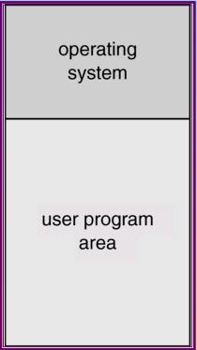
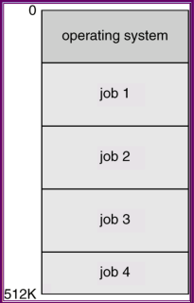
2. Multi programming Systems
OS picks up and begins to execute one of the jobs from memory.
Once this job needs an I/O operation, operating system switches to another job.
If several jobs are ready to run at the same time, CPU scheduling is to be done.
In non-multiprogrammed systems, there are moments when CPU is idle.
In multiprogramming system, CPU will never be idle and keeps on processing.
Primarily to optimize utilization of hardware.
Reduce setup time by batching similar jobs.
Automatic job sequencing.
Resident monitor.
Simple batch
system
Multi programmed
batch system

Slide 6
3. Multiprocessor Systems
Consists of several processors that share a common physical memory.
Provides higher computing power and speed.
In multiprocessor system all processors operate under single operating system.
I/O routine supplied by the system
Memory management
CPU scheduling
Allocation of devices
Eg. Windows NT, 2000, XP, and Unix,OpenBSD

Slide 7
4. Desktop Systems
Personal computers – computer system dedicated to a single user.
PC operating systems therefore were neither multiuser nor multitasking.
Instead of maximizing CPU and peripheral utilization, maximizing user convenience and responsiveness is opted
These systems are called desktop systems. Eg. PCs running with Windows and Apple Macintosh.
Eg. Windows, Apple's mac OS, Chrome OS, BlackBerry Tablet OS,

Slide 8
5. Distributed operating Systems
Distribute the computation among several physical processors.
Advantages of distributed systems
Resources Sharing
Powerful and inexpensive microprocessors
Computation speed up – load sharing
Reliability
Advanced Communications
Eg. LOCUS, MICROS, IRIX etc.

Slide 9
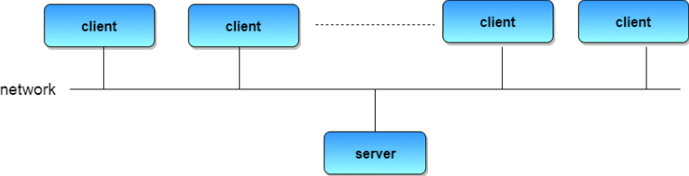
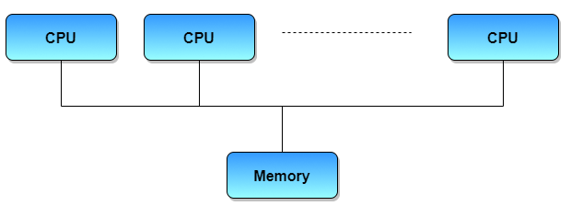
Types of distributed operating systems
1. Client-server systems 2. Peer-to-peer systems
Centralized systems today act as server In contrast to tightly coupled systems,
systems to satisfy requests of client systems. it uses a set of processors that do not
share a memory or clock.
Each process has its own local memory
They are loosely coupled systems

Slide 10
6. Clustered Systems
Like parallel systems, clustered systems gather together multiple CPUs to accomplish computational work.
Clustering allows two or more systems to share storage.
Provides high reliability and availability.
Asymmetric clustering: all nodes runs the application while other one node is in standby.
Symmetric clustering: all N hosts are running the application.
Eg. Solaris MC, UnixWare, MOSIX and GLUnix

Slide 11
7. Real-time Systems
It is an OS that give maximum time for each of the critical operations that it performs, like OS calls and interrupt handling.
Often used as a control device in a dedicated application.
Well-defined fixed-time constraints.
Real-Time systems may be either hard or soft real-time.
Hard real time systems: The RTOS which guarantees the maximum time for critical operations and complete them on time
Soft real time systems: RTOS that guarantees maximum of the time, to critical task by assigning priority over other tasks, but no assurity of completing it in a defined time.
Eg. FreeRTOS, VxWOrks, QNX etc.

Slide 12
7. Handheld Systems
Personal Digital Assistants (PDAs)
Cellular telephones
Issues:
Limited memory
Slow processors
Small display screens
Eg. Palm OS, Pocket PC, Symbian OS, Android, Linux etc.

Slide 13
Thank you!!

